Slide 1
Virtual Clothes Try-on
Team 38:
Jorge Olivares
Robin Martinez
Alan Vela
Sponsor:
Pranav

Slide 2
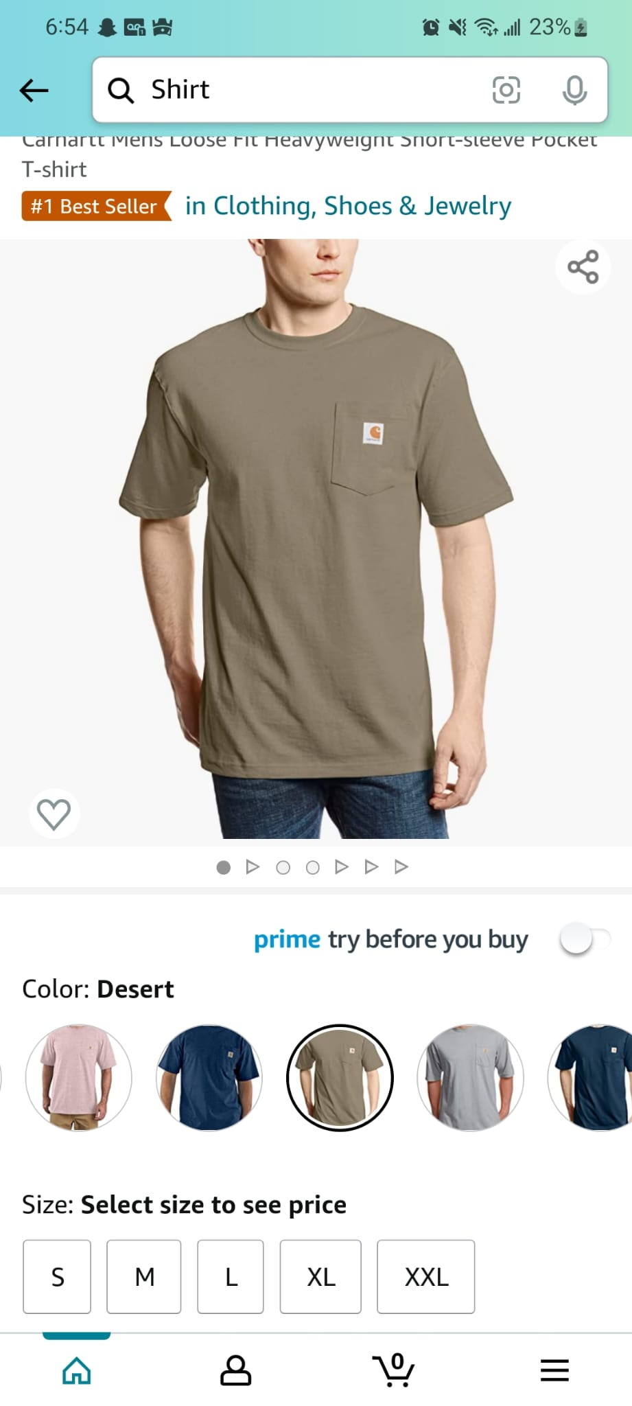
Problem Overview
Clothing industry has increased in the last few years at rapid pace. This has helped increase the demand on e-shopping.
However, customers can’t see how the clothes will fit and if they are not satisfied with them they will return them.
In many cases the returns are lost money for the company.

Slide 3
Proposed Solution
Create an application that is able to:
Store different clothing design
Can display an avatar of the user
Change the clothing of the avatar.

Slide 4
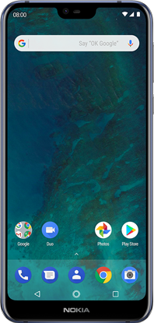
Overview
Neural Network
UI
Application Design
Shape Representation
Convolutional Architecture
Database
Loss Functions and Optimization
Clothing Companies
User with application
Green - Robin Martinez, Blue - Alan Vela, Red - Jorge Olivares, Purple - End Consumer

Slide 5
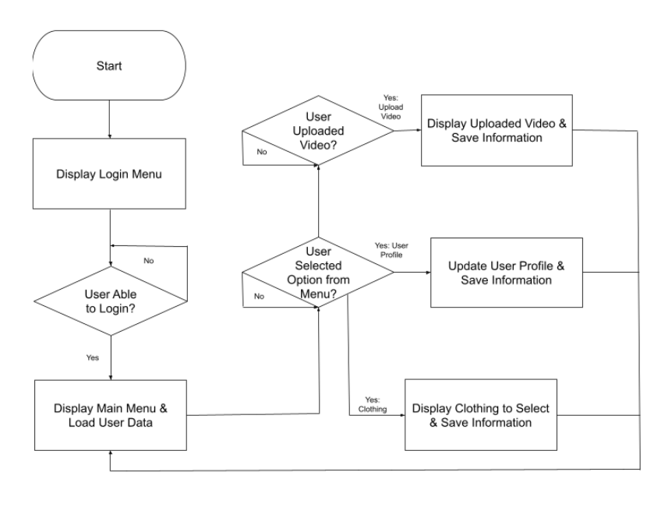
Phone App - FlowChart

Slide 6
Phone App - Major Challenges/Solutions
Challenges
Logins were not being stored
Display of upload video was very pixelated
Switching between Kotlin/Java
Solutions
Learned how to use Firebase to be able to store/test on my application
Had to upload smaller videos on Firebase
Focused on Kotlin

Slide 7
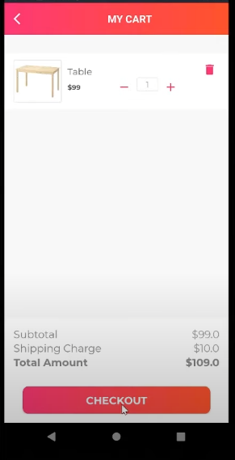
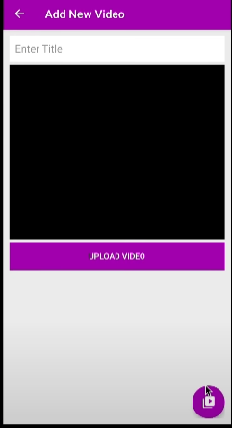
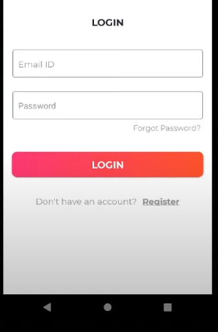
Phone App - Deliverables
Deliverables
Established a login/register
Set up an upload video
Item selection and shopping cart storing

Slide 8
Machine Learning Subsystem Overview
403 Deliverables
Octopus interoperability with Olympus server
Image processing pipeline
Modernized Octopus using Python3
Video Processing Pipeline
Splitting/Cropping Frames
Semantic Segmentation
Open Pose
Octopus
Python 3
Pytorch
Other Dependencies
Input Format:
.mp4
Output Format:
.obj

Slide 9
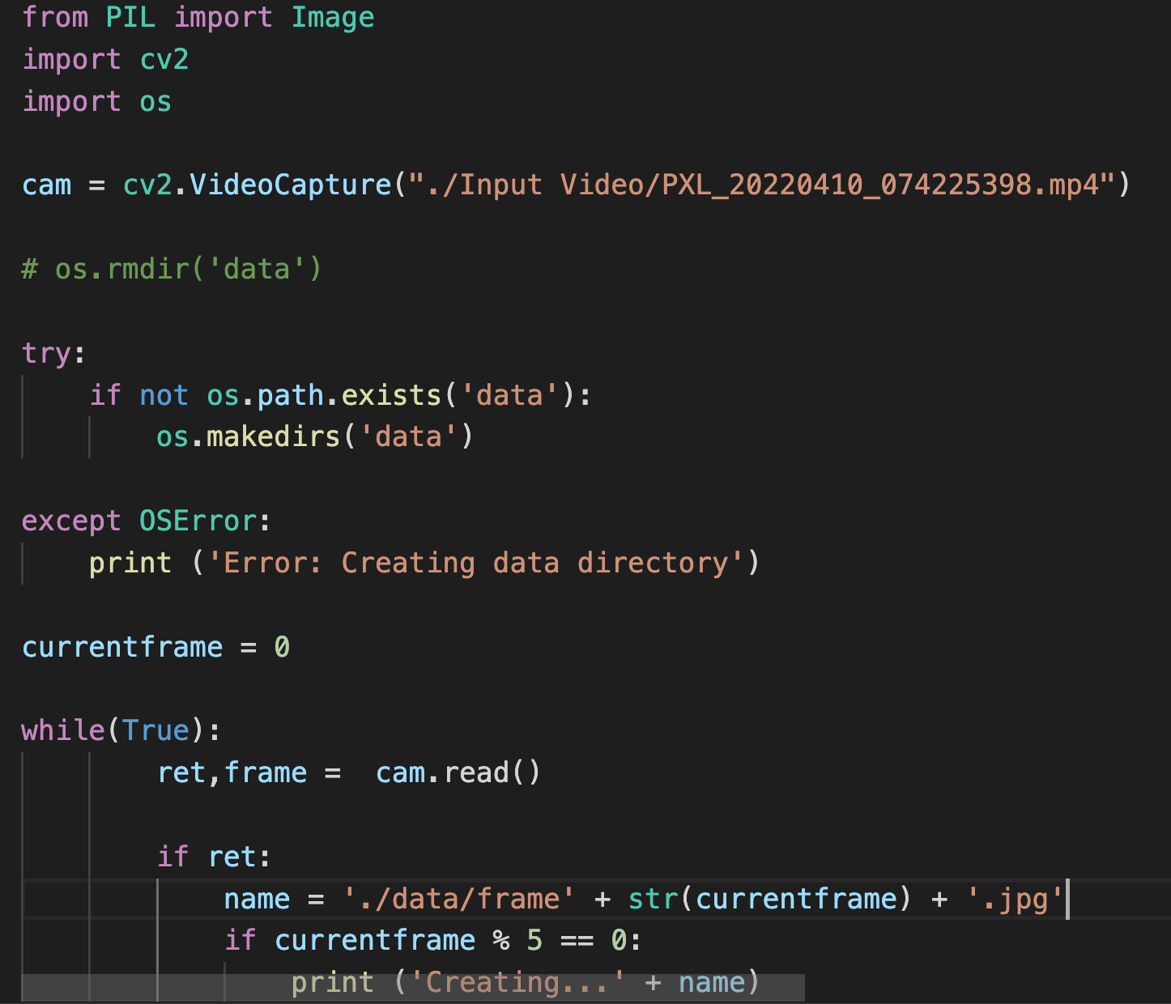
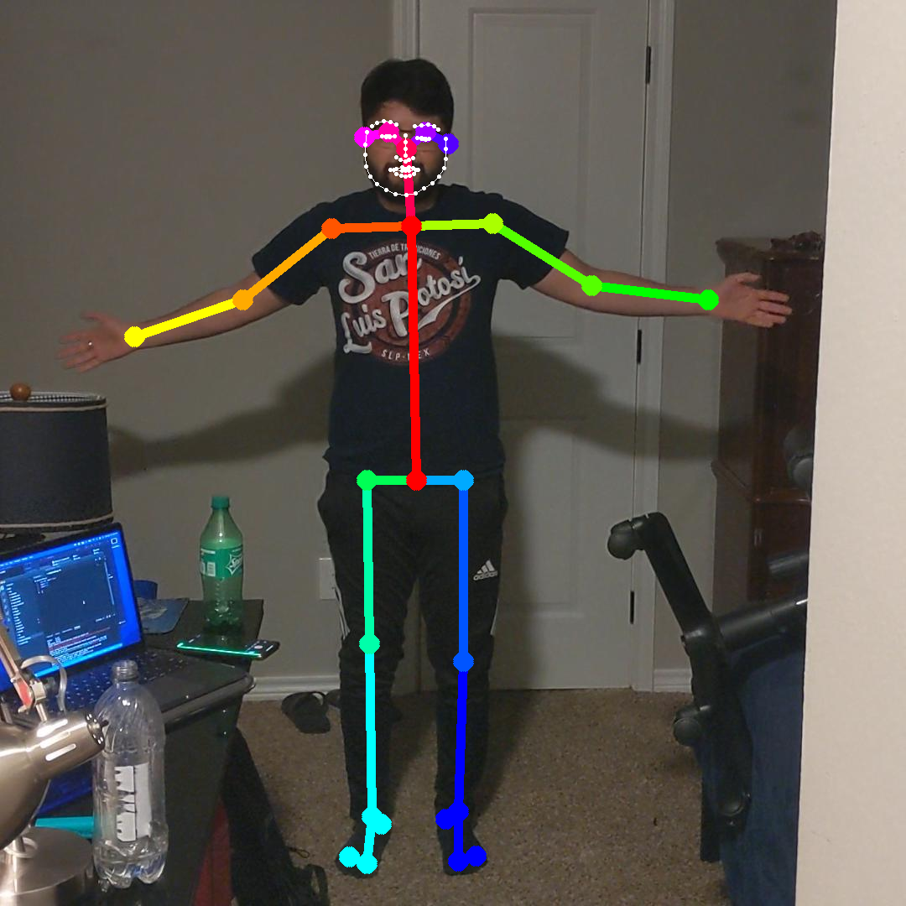
ML Subsystem Test/Validation Results
Challenges
Octopus out of date, no developer support
Despite building from source, couldn’t run Open Pose
Certain Octopus dependencies required root Access to install

Slide 10
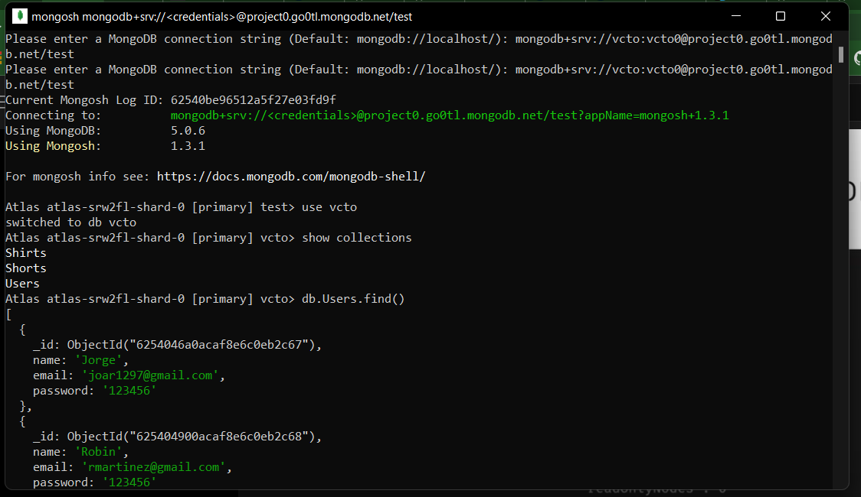
Cloud Database - Deliverables
Deliverables
Establish connection with database
Set up query
Populate database with Images

Slide 11
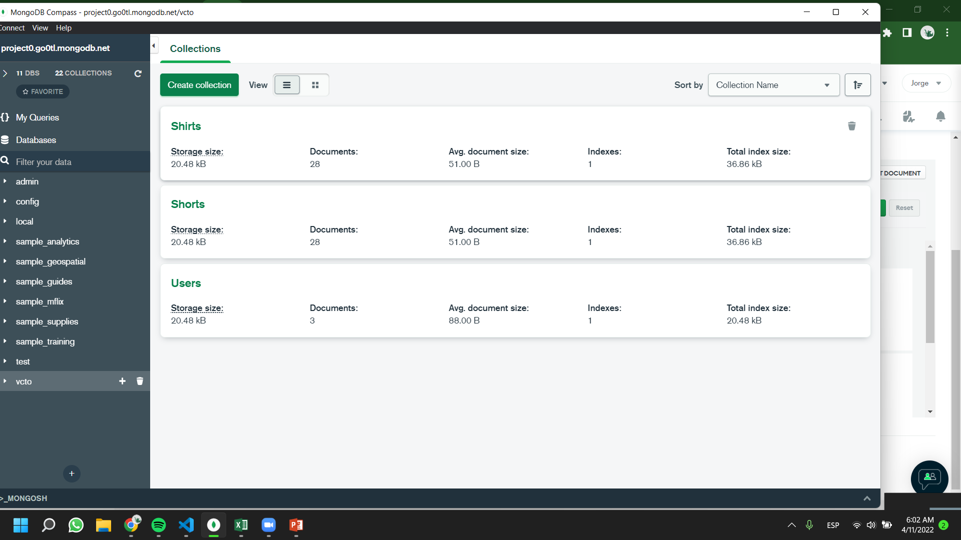
Cloud Database - Deliverables
Challenges
Connecting python script to cloud database
Uploading images to database.

Slide 12
404 Goals
Create clothing options and stored in the database
Validate communication between subsystems
Display avatar and clothing options on application
Train the final 3D model

Slide 13
Execution and Validation
 | 1/31/22 | 2/7/22 | 2/14/22 | 2/21/22 | 2/28/22 | 3/7/22 | 3/14/22 | 3/21/22 | 3/28/22 | 4/4/22 | 4/11/22 | 4/18/22 | 4/25/22
Researching Problem |  |  |  |  |  |  |  |  |  | Done
Splitting Subsystems |  |  |  |  |  |  |  |  |  | In Progress
Write ConOps |  |  |  |  |  |  |  |  |  | Behind
Midterm Presentation |  |  |  |  |  |  |  |  |  | Not started
Writing FSR, ICD
Learning Android Studio
Setup database
Updating Octopus Code
Establish connection with database
GUI Theme Created
Setup query system
Status Update Presentation
Populate Database with Images
GUI Layout
Train Neural Network
Final Presentation
Final Report

Slide 14
Questions?

